Slide 1
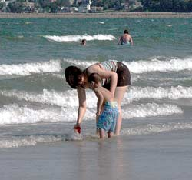
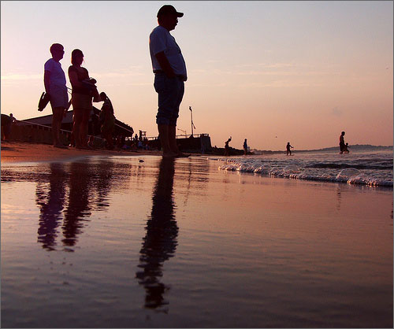
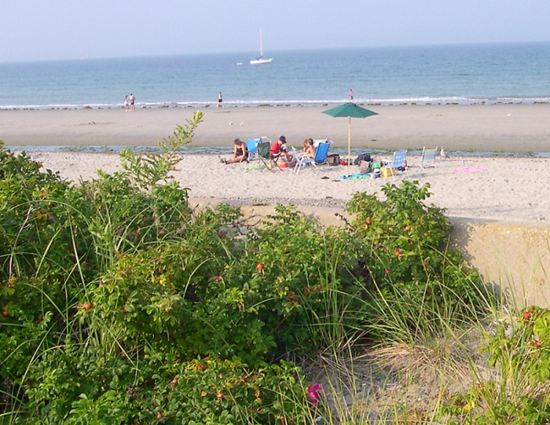
DCR Beaches Accomplishments
Presented to
Metropolitan Beaches Commission
April 8, 2013

Slide 2

DCR’s Vision for the Beaches
DCR’s mission is all about providing access for all to the Commonwealth’s cultural, natural and recreational resources while protecting the resources.
DCR’s vision includes continuing to provide people and their families with safe accessible beaches that we can all be proud of as was the stated goal of the First Metro Beaches Commission Report.
We know these beaches are year round community assets and need year round care and maintenance.

Slide 3

DCR’s Vision for the Beaches
Beaches are 365 day facilities and community assets which encourage healthy lifestyles by providing opportunities for recreation for walking and exploration for all seasons.
Each winter our focus of concern is often on the Coastal Beaches North of Boston due to the significant storm surges and storm impacts.

Slide 4
DCR’s Investment in the Beaches since 2008
Today, I will give you an overview of investment in the beaches since FY2008 through FY 2012 in comparison to 2006
Beach Management
Equipment
Capital Projects
Programming and Partnerships

Slide 5
Overview of DCR’S Investment in Beaches
DCR operates 88 beaches across the Commonwealth including 14 beaches in the metropolitan Boston area.
DCR spent $36,276,806 on beaches statewide in FY08, including $12M on the metropolitan area beaches.
This amount includes more than $23M in capital improvements and more than $10.6 in staff and other operating expenditures.
Notes:
Excerpts from Beach and Pool report which will be submitted to house and senate ways and means committee on December 15th.

Slide 6
Continued Investment
Although 2008 may have been a peak year. DCR continues to invest in the repair and rehabilitation of the infrastructure associated with the metropolitan beaches.
In 2012, DCR spent $ 4.7 million in operating and $8 million in capital for a combined total of over $12 M for 14 metropolitan beaches or 15% of DCR’s waterfront assets
This 2012 investment in the metropolitan beaches represents 35% of FY 2008 spending statewide for all the 88 beaches.

Slide 7
Metropolitan Beaches Budget Overview
Metropolitan Beaches Commission: Beach Expenditures Operating

Slide 8
Metropolitan Beaches Budget Overview
Metropolitan Beaches Commission: Beach Expenditures Capital
Fiscal Year | Capital Expenditures
2006 | $ 11,812,981
2008 | $ 7,708,816
2009 | $ 3,219,790
2010 | $ 2,951,935
2011 | $ 8,633,515
2012 | $ 8,173,047
Total for FY 2008-2012: | $30,687,103.37

Slide 9
New Model of Beach Management
Through the infusion of staff as a result of the first Metro Beaches Commission Initiative DCR created a new model of beach management .
Year round beach supervisors were hired along with a team of laborers and equipment operators to provide year round supervision of each beach complex resulting in higher maintenance standards.
This model of management was so successful in the Coastal District that it has been replicated across the state as part of the DCR’s unification of the parks divisions effort last year creating MassParks.
Notes:
Created year round supervision of beaches cluster:
Revere beach has year round cluster super. Late shift supervision in each cluster. State Parks Total = 64 positions [38 Urban Parks, 24 State Parks, 1 Operations, 1 Planning and Engineering]
A total of 58 Positions were completed [32 Urban Parks, 24 State Parks, 1 Operations, 1 P&E]
Of the positions completed 7 employees have since *left DCR [2 resigned, 3 were terminated, *2 candidates were approved though hiring process but did not report for work so technically they were not on payroll nor did they receive compensation]
Currently there are 12 openings in the Beaches account, of these:
3 candidate hiring packages have been at EOEEA since 9/25/08 awaiting approval [2 MEO I's UP - Harbor, 1 Laborer II UP-Harbor]
2 candidate hiring packages are going through the internal DCR signature process [VSS UP-Harbor, MEO II UP-Harbor]
The remaining vacancies include 5 Civil Service positions for UP [2 MEO I's and 3 Laborer II's]North and Harbor; Beach Manager for UP-Harbor, Administrative Assistant II for Operations [Fleet Mgmt]

Slide 10
Metropolitan Beaches Budget Overview
Metropolitan Beaches Commission: Overview Staffing Costs
FY | Total Staffing Costs for Fiscal Year | Total Positions for the Metropolitan Beaches
2008 | $ 4,502,988 | 390
2010 | $ 5,100,977 | 358
2012 | $ 4,574,831 | 327
* Based on straight salaries; no overtime costs are included.
** Note costs include union raises.

Slide 11
Metropolitan Beaches Budget Overview
Metropolitan Beaches Commission: Staffing Costs

Slide 12
New Model of Beach Management –
Operation Algae
Aggressive management of the algae problem in Lynn and Nahant has resolved the smell issue since 2008
DCR dedicates staff to monitor situation daily throughout most of the year. Operation Algae removal is a daily task during the season for the heavy equipment operator
Due to cost increases associated with disposal, DCR has spent $100,000 to date in FY2013 with an anticipated additional $50,000 by the end of the fiscal year.
Notes:
Created year round supervision of beaches cluster:
Revere beach has year round cluster super. Late shift supervision in each cluster. State Parks Total = 64 positions [38 Urban Parks, 24 State Parks, 1 Operations, 1 Planning and Engineering]
A total of 58 Positions were completed [32 Urban Parks, 24 State Parks, 1 Operations, 1 P&E]
Of the positions completed 7 employees have since *left DCR [2 resigned, 3 were terminated, *2 candidates were approved though hiring process but did not report for work so technically they were not on payroll nor did they receive compensation]
Currently there are 12 openings in the Beaches account, of these:
3 candidate hiring packages have been at EOEEA since 9/25/08 awaiting approval [2 MEO I's UP - Harbor, 1 Laborer II UP-Harbor]
2 candidate hiring packages are going through the internal DCR signature process [VSS UP-Harbor, MEO II UP-Harbor]
The remaining vacancies include 5 Civil Service positions for UP [2 MEO I's and 3 Laborer II's]North and Harbor; Beach Manager for UP-Harbor, Administrative Assistant II for Operations [Fleet Mgmt]

Slide 13
New Model of Beach Management
Maintenance Schedules on the Web
In May 2007, DCR first posted its spring maintenance schedule on the agency website. The schedule details the frequency and location of tasks such as mowing, weeding, cleaning restrooms, emptying trash barrels, removing litter, sanitizing beaches, inspecting playgrounds, sweeping parkways and parking lots, and cleaning catch basins in state parks and beaches and along parkways.
Publishing the schedule on the website helps hold DCR accountable for achieving its maintenance goals, and lets the public see how the agency deploys its resources to serve all its properties.
Notes:
Created year round supervision of beaches cluster:
Revere beach has year round cluster super. Late shift supervision in each cluster. State Parks Total = 64 positions [38 Urban Parks, 24 State Parks, 1 Operations, 1 Planning and Engineering]
A total of 58 Positions were completed [32 Urban Parks, 24 State Parks, 1 Operations, 1 P&E]
Of the positions completed 7 employees have since *left DCR [2 resigned, 3 were terminated, *2 candidates were approved though hiring process but did not report for work so technically they were not on payroll nor did they receive compensation]
Currently there are 12 openings in the Beaches account, of these:
3 candidate hiring packages have been at EOEEA since 9/25/08 awaiting approval [2 MEO I's UP - Harbor, 1 Laborer II UP-Harbor]
2 candidate hiring packages are going through the internal DCR signature process [VSS UP-Harbor, MEO II UP-Harbor]
The remaining vacancies include 5 Civil Service positions for UP [2 MEO I's and 3 Laborer II's]North and Harbor; Beach Manager for UP-Harbor, Administrative Assistant II for Operations [Fleet Mgmt]

Slide 14
“The maintenance schedule holds DCR accountable for doing many of the routine tasks in our parks that the taxpayers rightly expect us to do,” said DCR Commissioner Richard K. Sullivan Jr. “It shows our park users that we care about the cleanliness and upkeep of our facilities, and take very seriously our role as guardian of these extraordinary recreational assets.”

Slide 15
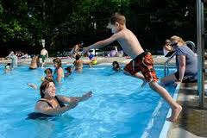
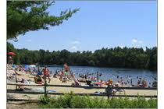
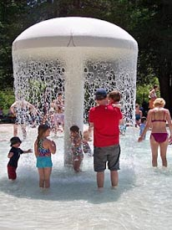
Statewide Aquatics Team established April 2012
Provides oversight and ensures compliance with DCR policy and procedures for both pools and beaches.
Provides efficient and direct oversight of maintenance, staffing , recruitment, training, policy and operational procedures.
Consists of Director, three Regional Aquatics Coordinators and Pool Coordinators to provide duty supervision at pools.
Integrated team into field operations with direct report to Deputy Director.
Ensures direct lines of responsibility for pools and beach operations.

Slide 16
Staffing – Putting them to Work
Benefits: More Coverage & Quality Staff
  Seven Day a week supervisory coverage
  Quality supervision of seasonal staff
  More frequent beach sanitizing due to more licensed equipment operators
  Later shift supervision and staffing on beaches allowing for late day bathhouse operation and staff presence
  Increased programming and work with Partners
Notes:
New staff yielded man benefits: for the beaches

Slide 17
Capital Equipment Purchases
In Fiscal Year 2008 $912,138.00 was spent on equipment for beach maintenance through a dedicated earmark
Investments continue from Fiscal Years 2009-2012 with spending on capital equipment totaling $414,853.00

Slide 18
Beach Equipment –
Major Purchases 2008
2 tractor Sanitizers: $192,399
2 five-ton trucks $155,800
6 half-ton pick-up trucks: $132,000
2 4x4 trucks: $47,422
5 Ford Ranger extended cab pick-up trucks: $90,000
4 one-ton trucks: $140,000
1 rebuilt 10-yard packer: $36,475
2 storage sheds $36,000
33 trash barrels with covers: $3,141
20 Big Belly solar trash bins: $80,000
6 dog bag dispensers: $2,328
1 interpretive equipment $8,500
6 lifeguard chairs $3,000
24 outdoor cigarette disposers $1,488
3 outdoor information boards (kiosk) $6,000
2 rebuilt 7-yard packer $22,000
TOTAL: $912,138
Notes:
Spring beaches press release 2008

Slide 19
Beach Equipment –
Major Purchases 2009-2012
(2) Surf Rakes $ 91,436.00
(2) Tractors for Surf Rakes $64,167.00
(1)Wide Area Mower BHI $79,067.00
(6) Message Boards $ 60,900.00
(1) Dump Truck with Plow $ 54,808.00
(1) 10 yard Packer Refurbished $ 35,600.00
(1) Dump Truck (used) $ 14,500.00
(1) Kubota $ 14,375.00
Total (15 pieces) $ 414,853.00

Slide 20
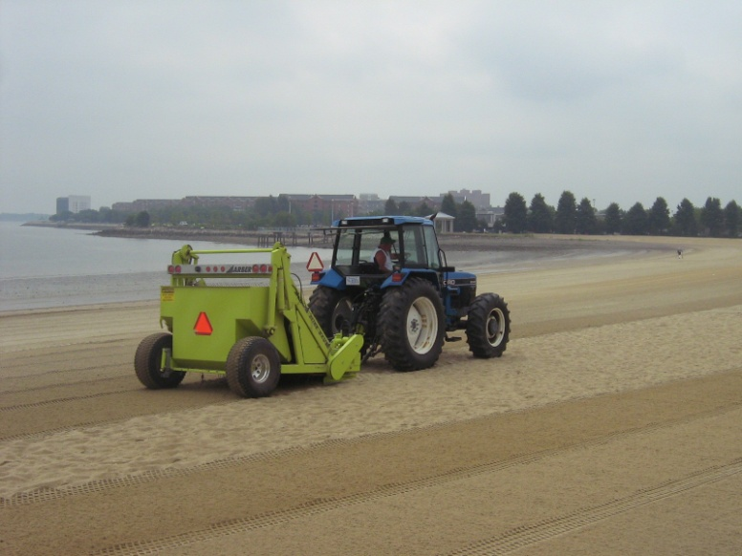
Equipment - Putting it to Use
Highlights
Barber Surf Rake with tractor: new advanced technology which allowed for increased sanitizing of the beaches.
Dump truck is tremendous addition during beach season and a year round asset in keeping areas abutting beach top notch.
New dump truck and garbage packer on Georges Island facilitated the removal of hard to dispose of marine debris that accumulates on the islands.

Slide 21
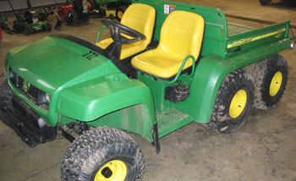
Equipment – Keeping Staff on the Move
New trucks enabled staff to stay on the move and respond more timely to maintenance needs, emergency response, and also facilitated random on site checks of lifeguard, beach front and park facilities.
Gators used daily on the beaches to expedite trash pick up and provide mobile Lifeguard patrols.

Slide 22
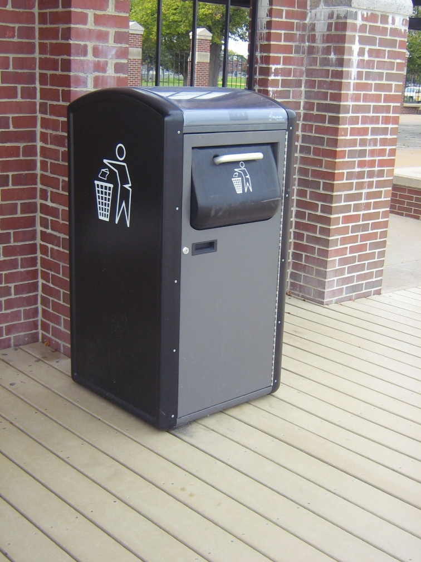
Equipment –
Going Solar to Keep Beaches Clean
In 2008, 20 Big Belly Solar Trash Compactors were piloted at the Beaches
They successfully reduced overflowing trash issues
Subsequently, 77 more Big Belly Solar Powered Trash Compactors were purchased through funding from Dept. of Energy Resources for $350,000.
Notes:
Massachusetts technology consortium collaboration. In kind gift of Trash Compactors.

Slide 23
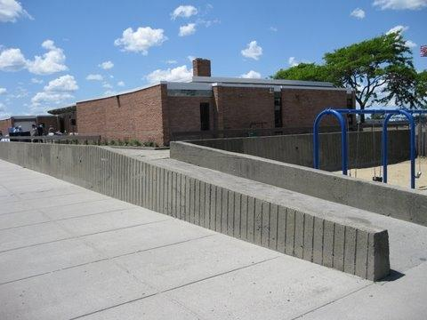
Capital Projects: Nahant
Ward Bath House Rehab $650,000
Rehab of the Ward Bath house enabled DCR to re-open this shuddered facility.

Slide 24
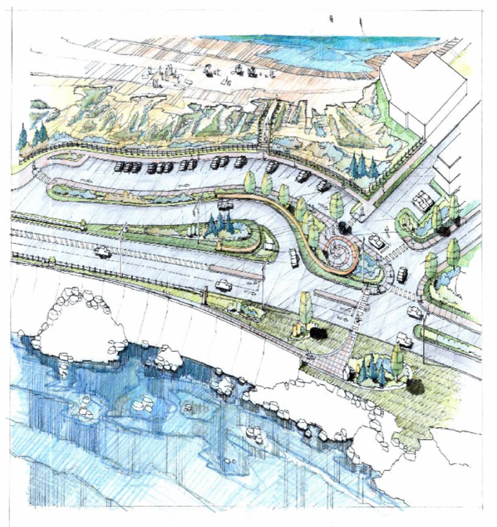
Capital Projects: Nahant
Nahant Beach Halfway House $2 million
  Construction of the comfort station facility at the
halfway point on Nahant Beach
Nahant Playground Improvements $3,310.00
Nahant Causeway $18 million
Nahant Reservation and Causeway: The construction and the rehabilitation of the Nahant Causeway and Nahant Reservation project includes rehabilitation of the Causeway seawall, drainage improvements, parkway reconstruction, street lighting and traffic safety improvements. In addition, the Nahant Reservation will feature: new landscaped entrance and exit, dune enhancement, pedestrian path improvements, parking lot circulation and safety improvements and ADA enhancements.

Slide 25
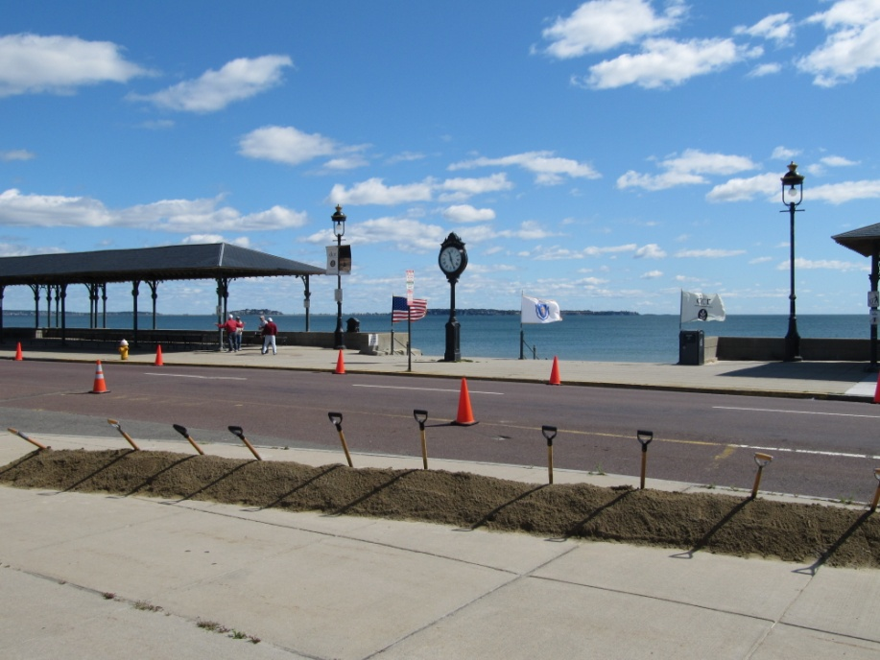
Capital Projects: Revere
Revere Phase 2 $12 million
From Revere Street to Carey Circle including drainage improvements, lighting improvements, parking changes, pedestrian improvements including the construction of beach side walking path, traffic improvements and landscape.

Slide 26
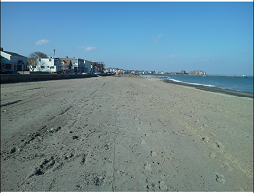
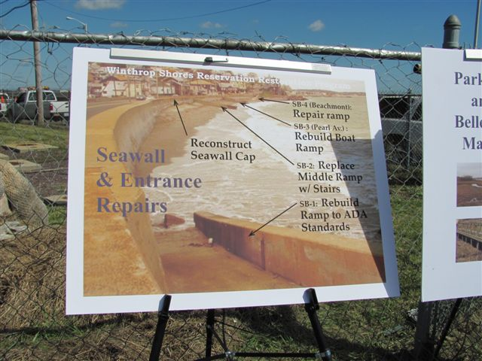
Capital Projects: Winthrop
Short Beach
Early action project of the Winthrop Shores Reservation Restoration Project
$4.5 million
Winthrop
Phase I $473,050
Phase II $2.5 million

Slide 27
Capital Projects: Improvements to Short Beach in Revere and Winthrop
The work at Short Beach is part of the Winthrop Shores Reservation restoration and includes:
installing new, wider sidewalks
repaving Winthrop Parkway
replacing the deteriorated seawall cap and beach ramps
installing new street lighting
creating a new pathway connecting to DCR’s Belle Isle Marsh Reservation constructing a new parking lot with an improved crosswalk connection to the beach area
and installing beach visitor amenities such as new seating, showers and foot washers, drinking fountains, bicycle racks, and “mutt mitt” dispensers for dog owners.
These improvements are also part of the overall “Back to the Beaches” program, with the goal of rehabilitating existing facilities and improving amenities for visitors to Boston Harbor-area beaches.

Slide 28
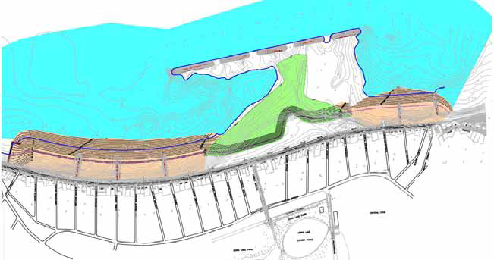
plumbing, electrical and structural of two major bathhouses at Nantasket Beach, $700,000.
plumbing, electrical and structural of two major bathhouses at Nantasket Beach, $700,000.
Winthrop Shores Reservation Project Phasing
Phase 2: “Pilot Project” &
South Nourishment Area
Phase 3: North
Nourishment Area
New Terminal
Groin
Dredge
Phase 1: Groin Repairs
Phase 4: Shore Drive (Upland) Improvements

Slide 29
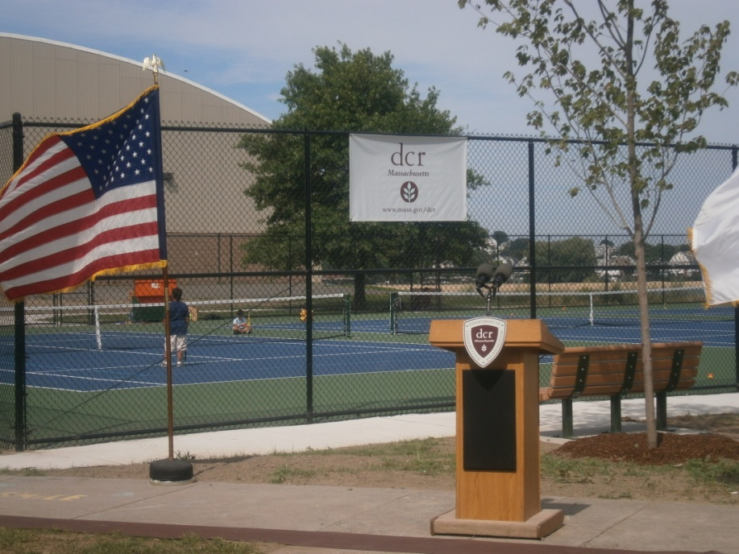
Capital Projects: East Boston
Constitution Beach Tennis Courts $300,000
Full Depth reconstruction of the tennis courts and reorientation to provide an additional court.
Improve views and safety of facility through landscaping enhancements

Slide 30
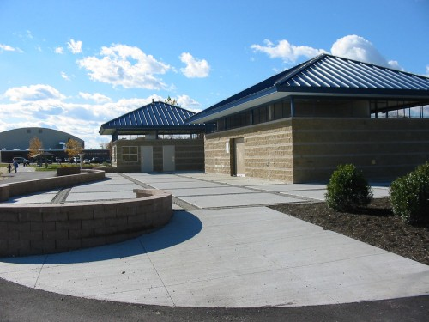
Capital Projects: East Boston
Constitution Beach Bathhouse Phase I
$2 million
Construction of the Bathhouse
and Lifeguard facilities
Constitution Beach Bathhouse Phase II $600,000
Construction of the Concession Building part of the project

Slide 31
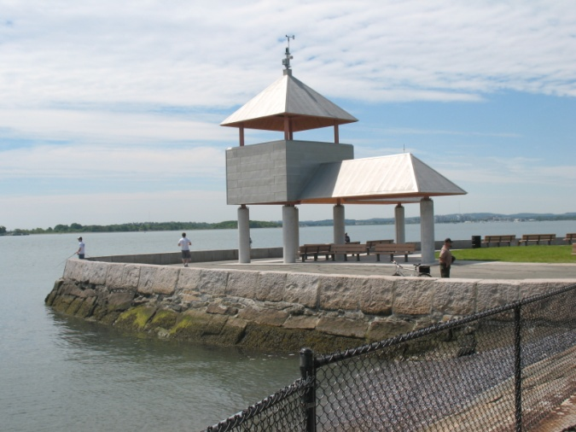
Capital Projects: South Boston
Pleasure Bay Sugar Bowl Shade Shelters were reconstructed $535,000
Marine Park Bathhouse Rehab in Progress. Projected Cost $400,000 Re-Opening planned for Summer 2013
Shelter at Sugar Bowl

Slide 32
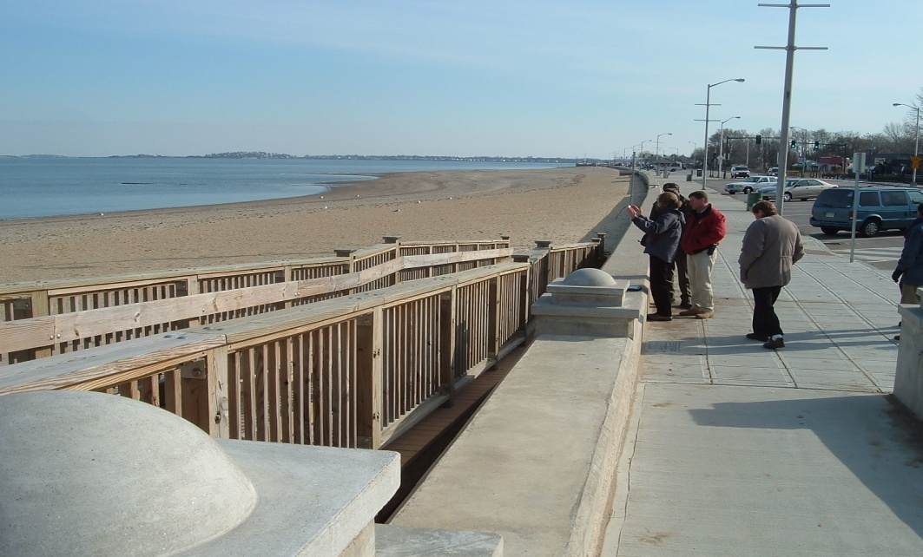
Capital Projects: Quincy
Wollaston Beach $7,800,000 Quincy Shore Drive Reconstruction
This project was a comprehensive rehabilitation of Wollaston Beach and Quincy Shore Drive. Project elements include replacement and upgrading of outdated parkway signalization, associated traffic calming features, reconfiguration of beach parking, improvement to pedestrian and bicycle facilities, addition of beach user amenities and recreational facilities and minor beach nourishment.

Slide 33
Capital Projects: Hull
Nantasket Beach $2.5 million
Access & Safety Improvements
Design, Permit and Construct the ADA access improvements to Nantasket Beach. This $2.5 million project included 3 ADA compliant ramps to the beach, the replacement of 2 vehicle ramps, 3 concrete stairs, replacing 5000 feet of safety railing, and hand railing. This project also included repairs to 5000 feet of concrete seawall.
Nantasket Beach Parking Lots $222,000
Nantasket Beach Sidewalks $155,000
Beaches Commission Improvements (2007-2008): New maintenance and lifeguard Equipment, new benches/picnic tables. Painting and de-leading of historic buildings, dune restoration project at North End of Beach, $466,000.

Slide 34
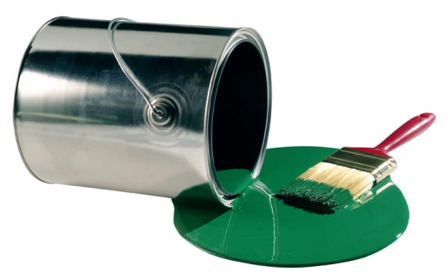
Curb Appeal at Beach Facilities
Revere Beach
Eliot House interior/exterior: All exterior and interior surfaces painted, repairs to doors, porches, walls ceilings, and floors refinished.
Carson Beach and Pleasure Bay
McCormack Bathhouse- remodel 2nd floor offices
Day Blvd benches- over 50 benches repaired
Nantasket Beach – Paint up the Beach
Mary Jeanette Murray Bathhouse and Bernie King Pavilion - exterior
Nantasket Beach Island District Office Complex including Old Police station, Garage exterior
Paragon Clock Tower Building- partially completed-building painting resumes March.
Notes:
Eliot House is at Revere Beach
Elliot House interior/exterior
All exterior and interior surfaces painted, repairs to doors, porchs, walls ceilings, and floors refinished. costs general repairs all contracted $15,000. Painting $1000 inmate labor
McCormack Bathhouse- remodel 2nd floor offices inhouse $14,000.(contractor estimates were $40-50k) All interior offices and 1st fl bathrooms painted $500 inmate labor.
Murray Bathhouse- painted exterior- $500 inmate labor
Nantasket Dist. Offices painted exterior- $900 inmate labor
Nantasket pavilion- interior/ exterior - $600 inmate labor
Paragon Clock Tower Building- tower completed-building painting resumes March. Tower painted $9600.
Old Police Station- building primed, painting resumes in March
Nantasket Labor Garage- interior painted $400 inmate labor exterior resumes in March.
Day Blvd benches- over 50 benches repaired- $4000

Slide 35
Programming Support on Beaches
On average DCR sponsors 142 programs on beaches each year in the metropolitan Boston area.
DCR sponsors these programs through staffing and providing program materials:
  Full time staff dedicated to programming on these beaches. Cost $90,774.32 and direct program costs of $7,000 per year.

Slide 36
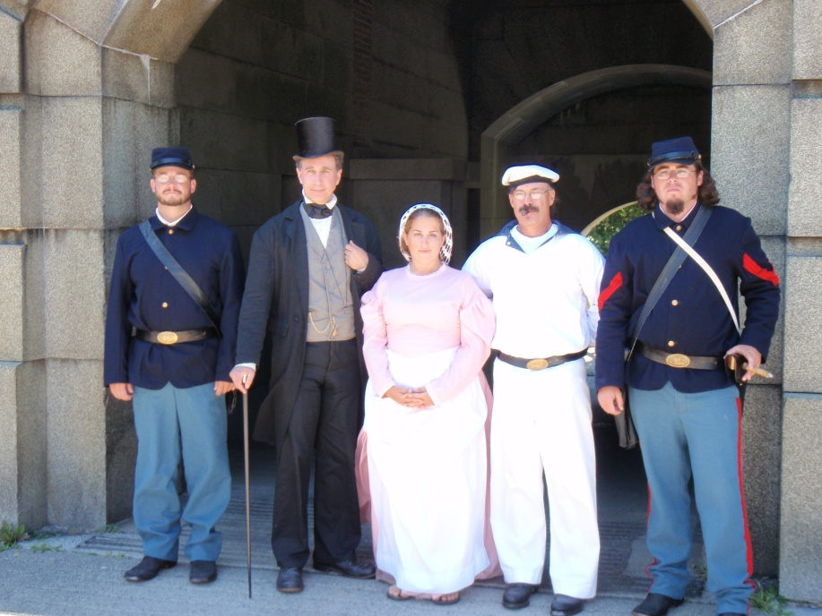
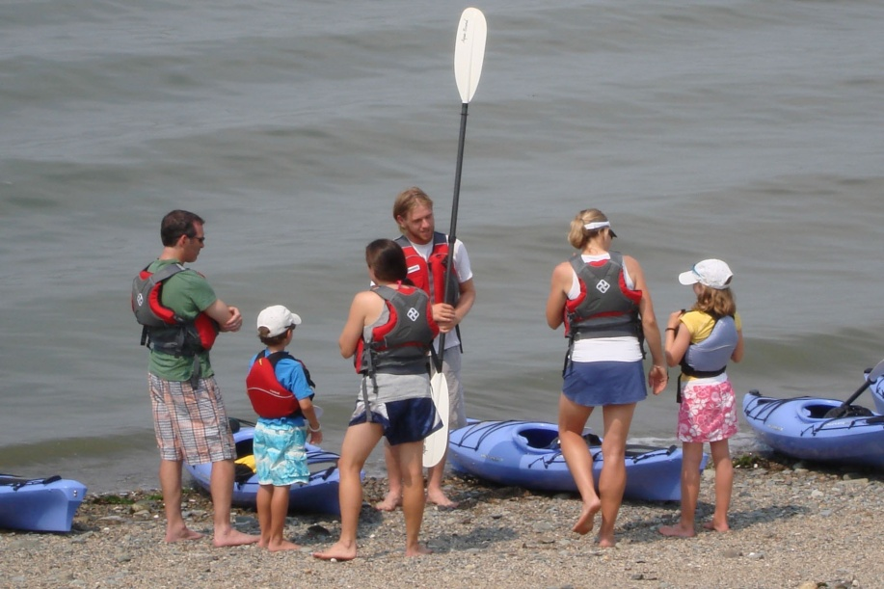
DCR Programs
Free introductory kayak program offered on the beach at Spectacle Island
DCR Ranger led costumed interpretive tour on Georges Island
Notes:
Creative new programs by DCR staff

Slide 37
Expanding Partnerships to Provide Community Beach Events
DCR supports on average 313 special events with in kind staffing contribution of $31,000.
Worked closely with Save the Harbor Save the Bay who through funding from the Boston Foundation and National Grid granted funds to provide seed money for community organizations interested in establishing new beaches programming and events.
Over 20 organizations benefited
Inaugural programs like a Revere beach Kite festival and Savin Hill and Malibu beach festivals benefited as well as more established events like “Endless Summer Celebration” at Nantasket beach.

Slide 38
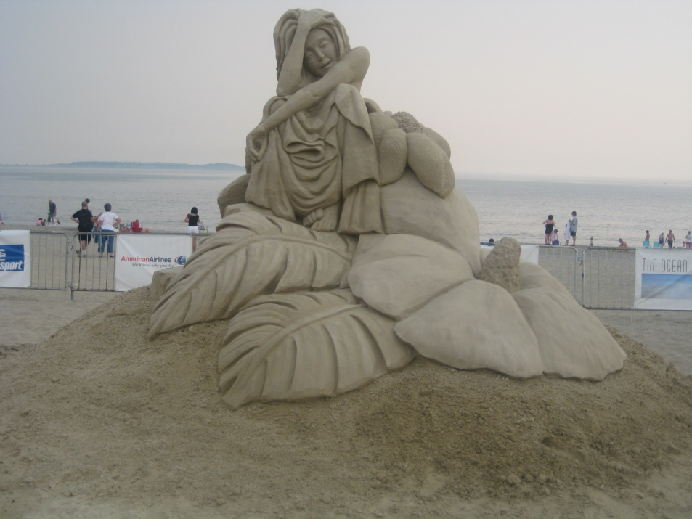
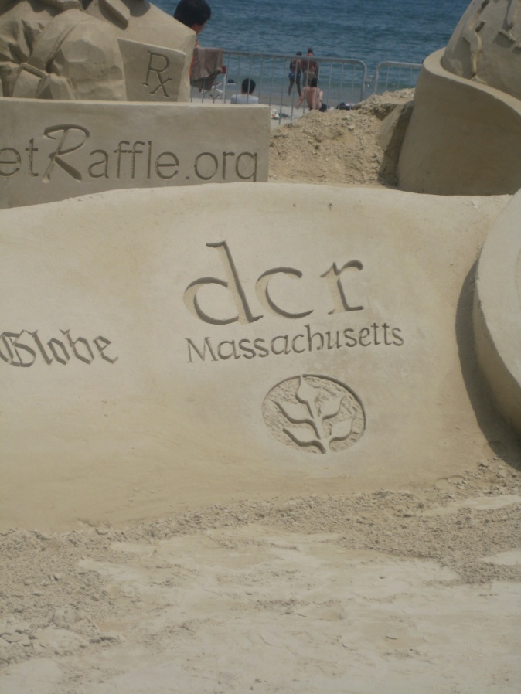
Hosting Community Beach Events
Revere Beach Sand Castle Competition continued to be a crowd favorite and a strong partnership.
Notes:
DCr continued a strong investment of staff on the ground to support this event.

Slide 39
Spectacle Island Improvements
The Rinse Off/Changing Station is on target to be constructed and ready in time for the opening of the Spectacle Island beach in June. We have had to make some design modifications to meet the restrictions imposed by the Landfill Post Closure Agreement and to satisfy DEP permitting requirements. It is an exciting project that will enhance the Spectacle Island beach experience. Last summer we used the temporary shower stations at the end of the pier. Visitation to the beach increased by 20%.
We continue to be in compliance with the Asbestos Containing Material (ACM) management plan for Spectacle Island. The caretaker performs daily walks around the island throughout the active summer season and weekly walks throughout the year. He picks up and coordinates disposal of asbestos. There has been a steady decline in ACM material washing up on the shores of Spectacle Island.
Notes:
The Rinse Off/Changing Station is on target to be constructed and ready in time for the opening of the Spectacle Island beach in June. We have had to make some design modifications to meet the restrictions imposed by the Landfill Post Closure Agreement and to satisfy DEP permitting requirements. It is an exciting project that will enhance the Spectacle Island beach experience. Last summer we used the temporary shower stations at the end of the pier. Visitation to the beach increased by 20%.
We continue to be in compliance with the ACM management plan for Spectacle Island. The caretaker performs daily walks around the island throughout the active summer season and weekly walks throughout the year. He picks up and coordinates disposal of asbestos. There has been a steady decline in ACM material washing up on the shores of Spectacle Island.

Slide 40
Capital Planning – Master Planning for the Future
Winthrop Shores –
  Phase 3 North End renourishment to bid soon
  Phase 4 Landside Improvements
Dorchester Bathhouses
  On list for comfort stations. Buildings already designed ( originally bid by DCAM and came in over budget)
Nantasket Beach Master Plan and Implementation
  Need to finalize traffic component

Slide 41
Capital Planning – Master Planning for the Future
  Nantasket: Waiting to determine Town of Hull’s plan for redevelopment which may have major impact on final plan
  Revere- Phase 3 Beaches Facilities Development to be built by private developer through sale of North Lot
  Revere- future playground new development

Slide 42
Water Quality Testing
Since 2008, DCR has engaged in a productive partnership with Save the Harbor Save The Bay, Mass DPH, MWRA and the City of Boston to improve processes and public communication regarding water quality testing and flagging procedures at several marine beaches in the Metropolitan Boston Area.
The collaboration has helped develop DCR's procedures for precautionary postings following rain events, protocols for posting beaches when multiple conflicting samples are received, and our ability to enhance sample collection at key beaches.
DCR continues to rely on this valuable partnership to explore new approaches to water quality monitoring to improve sampling accuracy and the timeliness of its communications to the public.

